Slide 2
Use TF-IDF to get keywords
Apply stopwords form the Natural Language Toolkit
2<=Keywords length <=25
Words Frenquency >=10
We get 32 keywords.
final_keywords = [ 'authentication', 'authorization', 'signin', 'signup', 'oauth', 'session', 'password', 'credential', 'access', 'refresh token', 'jwt', 'sso', '2fa', 'mfa', 'security', 'login page', 'logout', 'user management', 'user account', 'login failure', 'captcha', 'recovery', 'reset password', 'account lockout', 'secure login', 'identity verification', 'api key', 'access token', 'bearer token', 'auth token' ]

Slide 3
Search issues by keywords
Use these keywords as input of search API
After the deduplication, we get 2398 closed issues from 89 repos which contains at least one keyword
Then manually select the issues is:
With a fix commit
The link of fix commit is still available and accessible.
We get 369 issues from 44 repos.

Slide 4
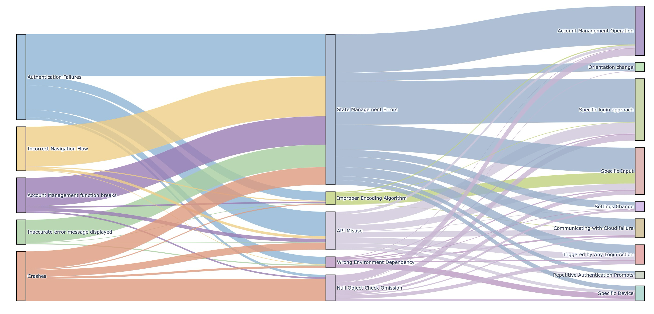
Symptoms
Root causes
Trigger Conditions

